Slide 1
Project Title
Presented By:
EVA SEXENA(210303105327)
B.NARENDRA(210303124043)
M. NAGESH (210304124086)
RAVI (210303124043)
Guided By:
Faculty Name:KIRAN MACWAN
Designation
CSE Department
PIET, Parul University
Internal Project Presentation August, 2024

Slide 2
Content
Introduction
Problem Statement
Research Paper Summary (in Tabular form)
Flowchart of the system
Implementation Details
Demonstration of the Project
Testing
Test cases
Conclusion
Future Work
References

Slide 3
Introduction
A face analyzer is software that identifies or confirms a person's identity using their face. It works by identifying and measuring facial features in an image. Facial recognition can identify human faces in images or videos, determine if the face in two images belongs to the same person, or search for a face among a large collection of existing images. Biometric security systems use facial recognition to uniquely identify individuals during user onboarding or logins as well as strengthen user authentication activity. Mobile and personal devices also commonly use face analyzer technology for device security.
Face recognition is a popular application of computer vision and machine learning that involves identifying or verifying the identity of an individual based on their facial features. In Python, there are several libraries and frameworks that can be used to build face recognition systems, including OpenCV, face_recognition, and dlib.
OpenCV: OpenCV is a computer vision library that provides a wide range of functions for image and video processing, including face detection and recognition.
face_recognition: face_recognition is a Python library that provides a simple and easy-to-use interface for face recognition, including face detection, alignment, and matching.
dlib: dlib is a modern C++ library that provides a wide range of functions for computer vision and machine learning, including face recognition

Slide 4
Problem Statement
The concept of face recognition is to give a computer system the ability of finding and recognizing human faces
fast and precisely in images or videos. Numerous algorithms and techniques have been developed for improving
the performance of face recognition. Recently Deep learning has been highly explored for computer vision
applications. Human brain can automatically and instantly detect and recognize multiple faces. But when it
comes to computer, it is very difficult to do all the challenging tasks on the level of human brain. The face
recognition is an integral part of biometrics. In biometrics, basic traits of human.

Slide 5
Summary
Sr. number | Paper Title | Publisher | Year
1 | faceregognition tecnique | Takeo Kanad | 1970
2 | Teaching computers to recognize human faces | Woody Bledsoe | 1960
3 | A face recognition method based on principal component | IEEE | 2021
4 | Face mask detection using deep learning | IEEE | 2021

Slide 6
9 | REVIEW ON FACE | IEEE | 2021
10 | Privacy implications | science | 2021
11 | systems against deepfake | IEEE | 2023
12 | Detecting tampering | IET | 2022
13 | Security analysis | ACM Computing Surveys | 2020
14 | Protecting facial | IEEE | 2021
15 | Faces in the Cloud | Cato Institute | 2020
16 | Differential Privacy | ACM SIGKDD | 2021
17 | Ethics of Facial Recognition | Busemeyer | 2022

Slide 7
SR NUMBER | PAPER TITLE | PUBLISHER | YERA
5 | LBPH Based Improved Face Recognition At LowResolution | Awais ahmed | 2018
6 | USING OPENCV | RAMDHAN TH.HASAN | 2021
7 | THE REAL TIME DETECTION | N.NIRANJINI | 2021
8 | ATTENDANCE SYSTEM | IEEE | 2020

Slide 8
18 | Detecting Adversarial | ACM SIGKDD | 2020
19 | Security Vulnerabilitie | BLACK HAT USA | 2019

Slide 9
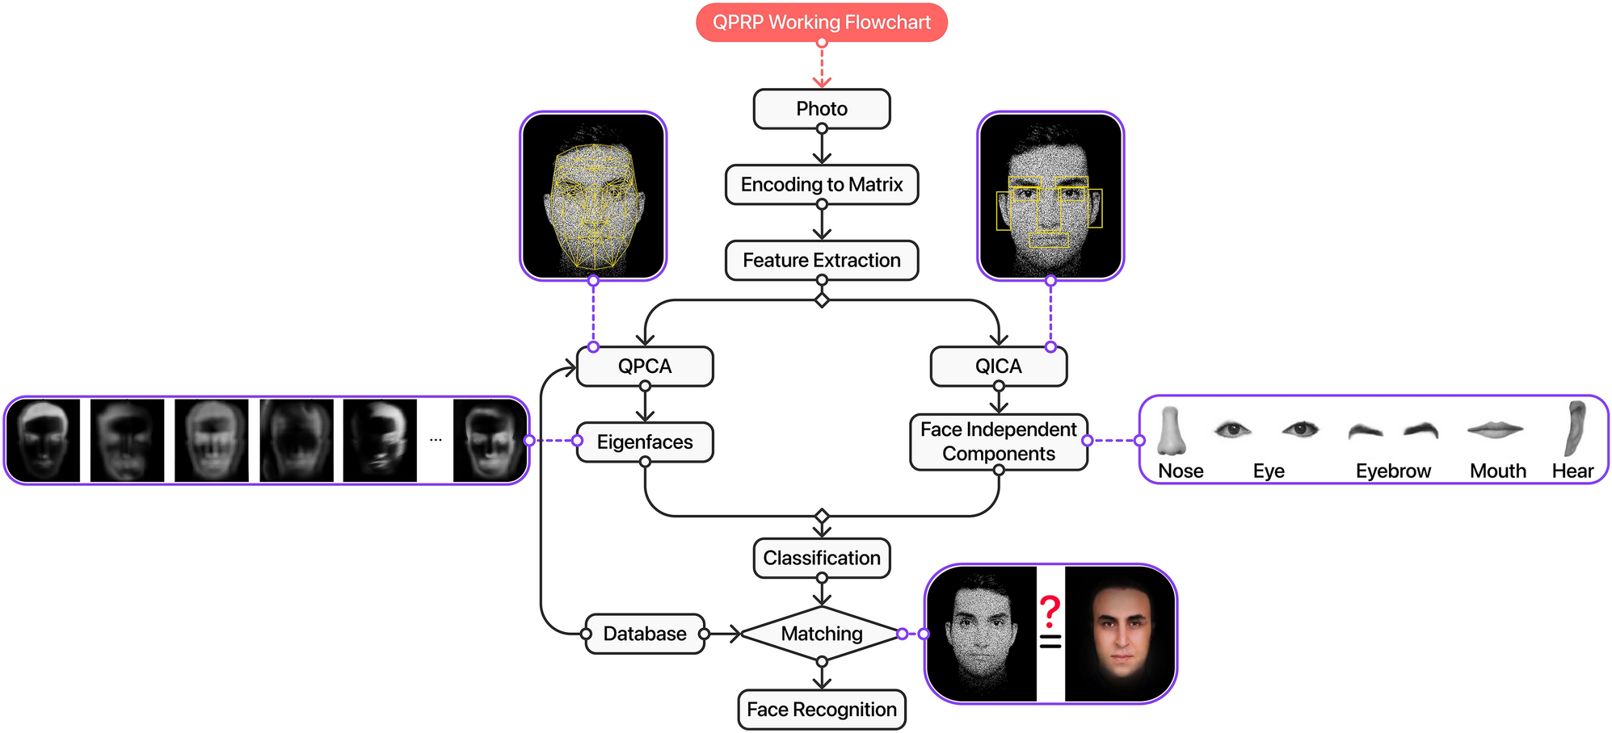
Flowchart of the system

Slide 10
Implementation Details
Face Detection
The face_recognition library uses the HOG (Histogram of Oriented Gradients) algorithm for face detection.
The HOG algorithm is a feature extraction method that detects faces by analyzing the distribution of gradient orientations in an image.
The library provides a face_locations function that returns a list of face locations in the image, represented as tuples of (top, right, bottom, left) coordinates.
Face Alignment
The face_recognition library uses the dlib library's face alignment algorithm to align the detected faces.
The face alignment algorithm uses a convolutional neural network (CNN) to detect facial landmarks (e.g., eyes, nose, mouth) and align the face to a standard position.
The library provides a face_landmarks function that returns a dictionary of facial landmarks for each face in the image

Slide 11
Face Encoding
The face_recognition library uses a convolutional neural network (CNN) to extract face features from the aligned faces.
The CNN is trained on a large dataset of faces and learns to extract features that are robust to variations in lighting, pose, and expression.
The library provides a face_encodings function that returns a list of face encodings, represented as 128-dimensional vectors.
Face Matching
The face_recognition library uses the L2 distance metric to compare face encodings and determine the similarity between two faces.
The L2 distance metric calculates the Euclidean distance between two vectors.
The library provides a compare_faces function that returns a list of boolean values indicating whether each face in the image matches a known face in the database

Slide 12
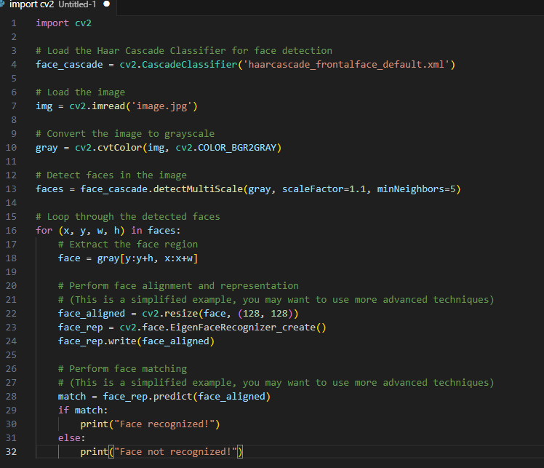
Screen shots of implemented work

Slide 13
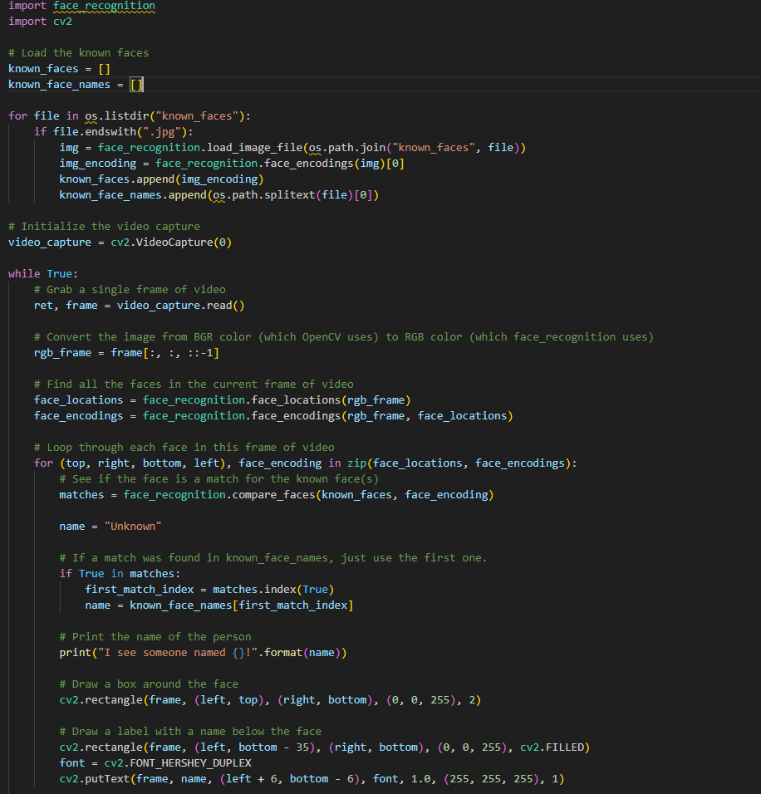
Screen shots of implemented work

Slide 14
Testing a Face Recognition Project in Python
Facial recognition is a popular application of computer vision and machine learning. In Python, there are several libraries that can be used for facial recognition, including OpenCV, face_recognition, and dlib.
To test a face recognition project in Python, you can follow these steps:
Collect a dataset: Collect a dataset of images of faces, with each image labeled with the corresponding person's name or ID.
Split the dataset: Split the dataset into training and testing sets (e.g., 80% for training and 20% for testing).
Train a model: Train a face recognition model using the training dataset. You can use libraries like OpenCV, face_recognition, or dlib to train a model.
Test the model: Test the trained model using the testing dataset. Evaluate the model's performance using metrics such as accuracy, precision, recall, and F1-score.
Evaluate the model: Evaluate the model's performance on a separate test dataset to ensure it generalizes well to new, unseen data

Slide 15
Conclusion
Face recognition technology has come a long way in the last twenty years. Today, machines are
able to automatically verify identity information for secure transactions, for surveillance and
security tasks, and for access control to buildings etc. These applications usually work in
controlled environments and recognition algorithms can take advantage of the environmental
constraints to obtain high recognition accuracy. However, next generation face recognition
systems are going to have widespread application in smart environments -- where computers and
machines are more like helpful assistants.
• To achieve this goal computers must be able to reliably identify nearby people in a manner that
fits naturally within the pattern of normal human interactions. They must not require special
interactions and must conform to human intuitions about when recognition is likely. This implies
that future smart environments should use the same modalities as humans, and have
approximately the same limitations. These goals now appear in reach -- however, substantial
research remains to be done in making person recognition technology work reliably, in widely
varying conditions using information from single or multiple modalities.

Slide 16
Future Work
• Zhang, Y., Feng, X., & Yan, X. (2020). Sentiment Analysis of Chinese social
media Using Deep Reinforcement Learning. IEEE Access, 8, 136821-136831.
• Arifin, A. Z., Dhandapani, P. W., & Peregrinate, A. (2021). Sentiment Analysis of
Indonesian social media Using a Hybrid Approach. International Journal of
Advanced Computer Science and Applications, 12(4), 190-198.
• Zhang, Y., Feng, X., & Yan, X. (2021). Dynamic Emotion Detection and Multi_x0002_task Learning for Sentiment Analysis of Microblogs. IEEE Transactions on
Computational Social Systems, 8(1), 190199.
• Khalid, H., Saeed, S., & Naz, S. (2020). Sentiment Analysis of COVID-19 Tweets
Using Deep Learning Techniques. IEEE Access, 8, 209707-209716.

Slide 17
References
• Zhang, Y., Feng, X., & Yan, X. (2020). Sentiment Analysis of Chinese social
media Using Deep Reinforcement Learning. IEEE Access, 8, 136821-136831.
• Arifin, A. Z., Dhandapani, P. W., & Peregrinate, A. (2021). Sentiment Analysis of
Indonesian social media Using a Hybrid Approach. International Journal of
Advanced Computer Science and Applications, 12(4), 190-198.
• Zhang, Y., Feng, X., & Yan, X. (2021). Dynamic Emotion Detection and Multi_x0002_task Learning for Sentiment Analysis of Microblogs. IEEE Transactions on
Computational Social Systems, 8(1), 190199.
• Khalid, H., Saeed, S., & Naz, S. (2020). Sentiment Analysis of COVID-19 Tweets
Using Deep Learning Techniques. IEEE Access, 8, 209707-209716.

Slide 18
Thank you

